Slide 2
About the company
Railway transportation
Sea and river transportation
Transportation of oversized and heavy cargoes
Project logistics
Transportation in the Arctic
Agency service
Stevedoring
Bunkering
Provision and spare pack supply
Warehouse logistics
Customs brokerage
Container shipping
Auto haulage
Asset management including distressed
The largest independent freight forwarder in Russia since 1929
Provides a full range of services for the delivery and cargo-handling in Russia and abroad:
Sovfracht is a reliable partner with an extensive expertise in the field of cargo transportation and asset management

Slide 3
Our awards and ratings
2016 – in the top-6 of the most dynamically growing logistics companies in Russia
In the top 20 of Russian transport operators
EOY – 2015 Russia, nomination Transport, EY
2015 – award of the Ministry of transport Best logistics solution for the organization of loading and unloading operations in the Arctic, port of Sabetta
In the top 500 of biggest companies in Russia, ranking RBC 500
In the top 6 for rail transportation of oil cargoes
Best National intermodal transport operator 2009-2014
2017 - The Company of the year business prize winner (ranking Best.ru – 2017)

Slide 4
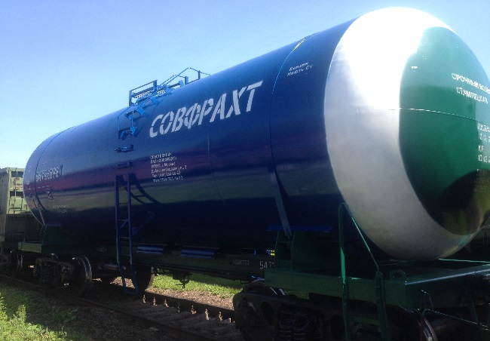
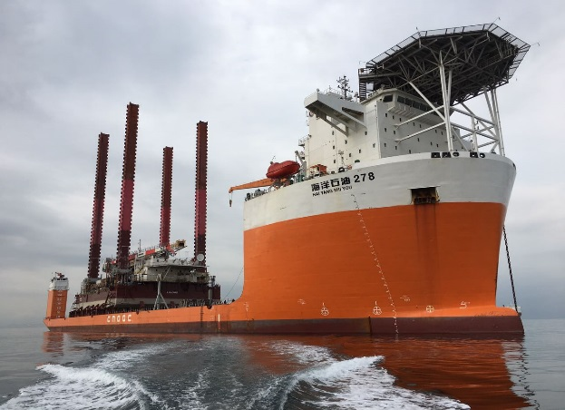
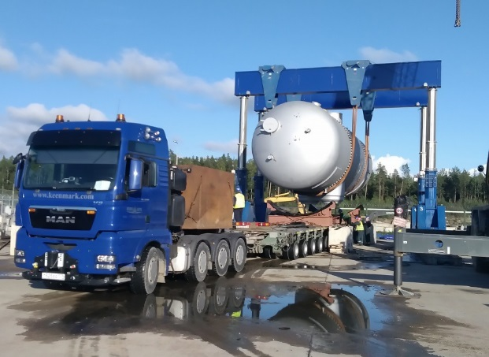
Indicators, 12 months of 2017
Operating results
Traffic volume, million tons……………………………………………….................... 19,4
Traffic volume, thousand TEU…………………………………………...…………….. 98
Financial results
Revenue (excluding VAT) and loaded railway tariff, billion rubles …….................... 32,5
EBITDA, billion rubles …………………………………………………………………… 2,59
Rolling stock management
Railway transport, in pieces…………………………………………………..............16 764

Slide 5
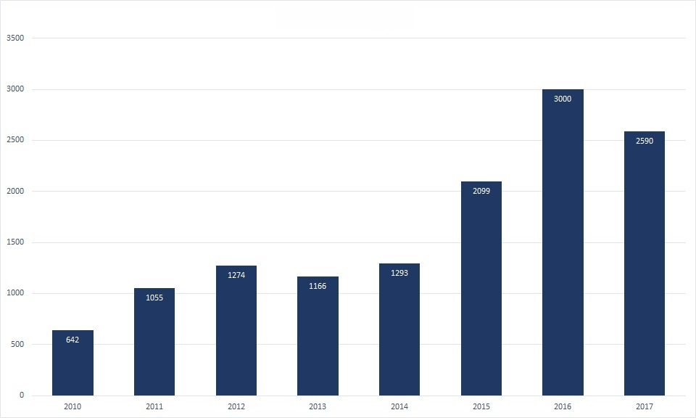
The dynamics of financial growth, 2010-2017
EBITDA, million rubles

Slide 6
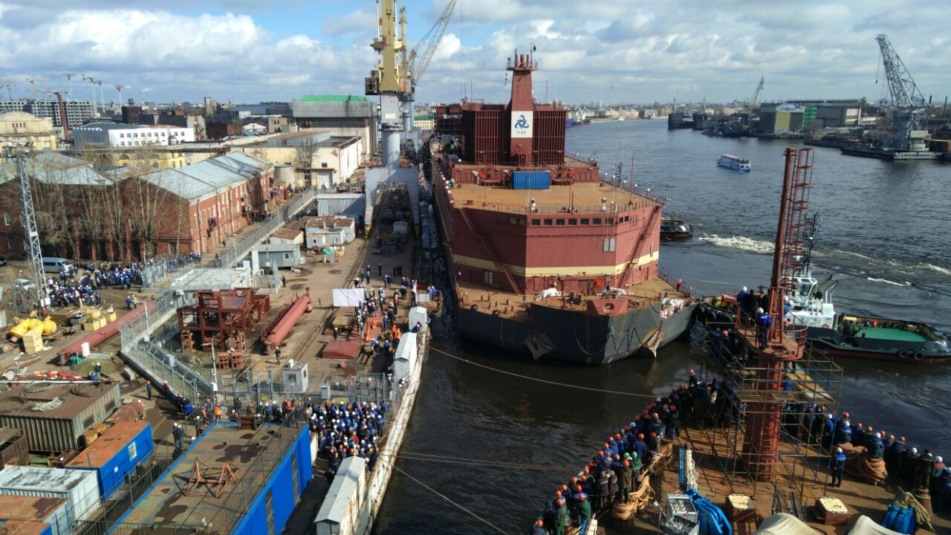
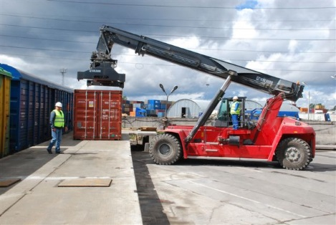
Indicators, six months of 2018
Operating results
Traffic volume, million tons……………………………………………….................... 7,3
Financial results
Revenue (excluding VAT) and loaded railway tariff, billion rubles …….................... 14,7
EBITDA, billion rubles …………………………………………………………………….1,36
Rolling stock management
Railway transport, in pieces…………………………………………………..............19 510

Slide 7
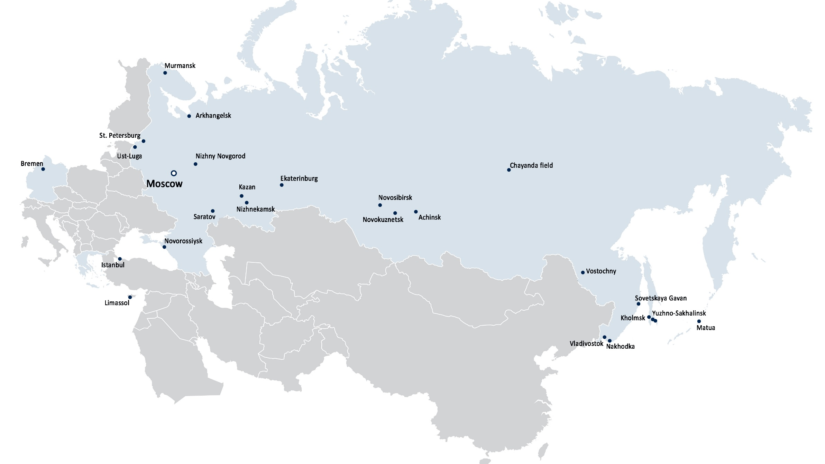
Network of regional representative offices

Slide 8
Railway transportation
JSC Sovfracht is one of the leaders of the railway cargo transportation market of Russia:
Carries 5% of all railway transportation of oil cargoes in Russia
6th place in Russia in terms of oil-cars in ownership and in management
25 main grounds of loading, 57 loading stations in Russia, Belarus and Kazakhstan
"We continuously work on choosing contractors, costs optimization, control of time schedule of rolling stock and reducing of down time. That finally produce a positive economic effect for our clients. Therewith we on principle no make a compromise in point of the quality of our services if it may put at risk the production process of our clients. The main principle of our work is to fulfill commitments 100%".
Sergey Voronin, First Deputy General Director of JSC Sovfracht

Slide 9
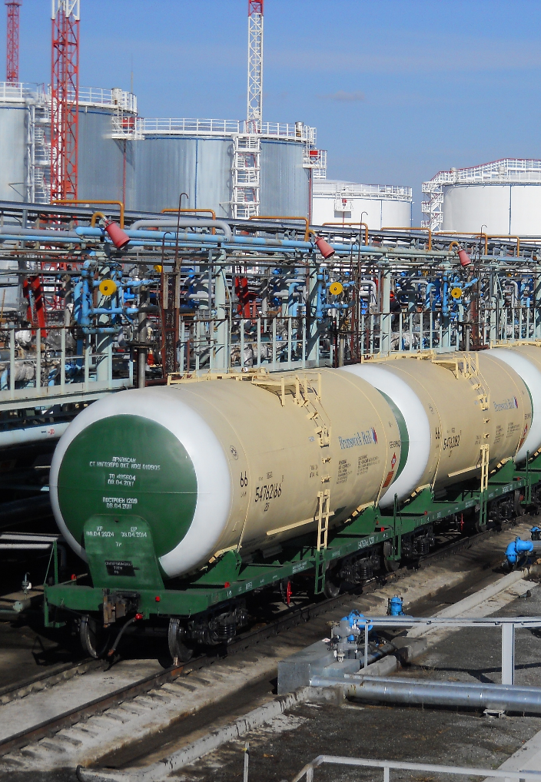
Railway transportation
JSC Sovfracht is:
Partner of Russian Railways in the nomination The Best logistics company – forwarder
Best logistics partner of the Sverdlovsk railway
The best partner TSFTO - JSC Russian Railways
Railroad transportation in the domestic and international market:
1. Expert investigation of transportation project at the planning stage
2. Selection and implementation of logistics solutions on the optimal scheme of transportation
3. Uninterrupted supply of rolling stock in the optimal amount
4. The provision of additional services, including financial instruments

Slide 10
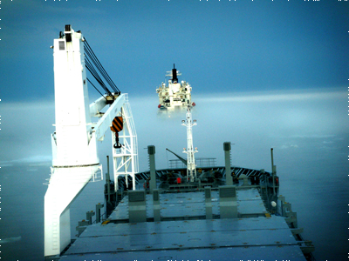
2009-2010: Shipping 3 sets of gas turbine
The delivery of three sets of gas turbine Siemens from the port of Norcheping (Sweden) to Priobskoye field of JSC NK Rosneft Total transportation volume: 5 000 m3 / 1 000 t List of works done:
Organization of storage at the port of Norcheping from November 2009 to July 2010
Construction of a temporary warehouse, loading on Board ship
Transshipment on barges in the Gulf of Ob
River transportation
Delivery to the mounting location
Obtaining a permit for the vessel under a foreign flag in the Gulf of Ob
Coordination of vessel's passage along the Northern sea route
224 places, including 6 oversized, heavy weight up to 100 tons

Slide 11
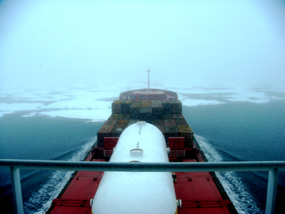
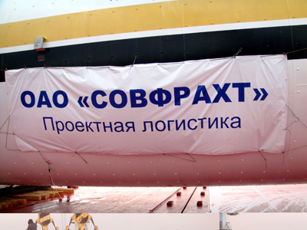
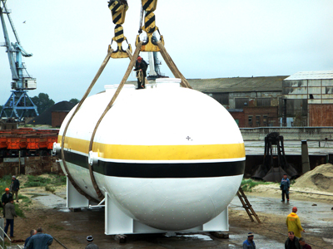
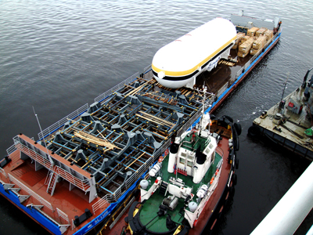
2010: Transportation of torchlight separator
The transportation of torchlight separator (oversized heavy weight) from Volgodonsk to Vankor field (navigation 2 weeks per year) for CJSC Vankorneft
Volume of cargo: 1150 m3 / 107 t
List of works done:
Transportation by river boat
Transportation by sea vessel
Transshipment into a barge in the port of Dudinka
Delivery to the field

Slide 12
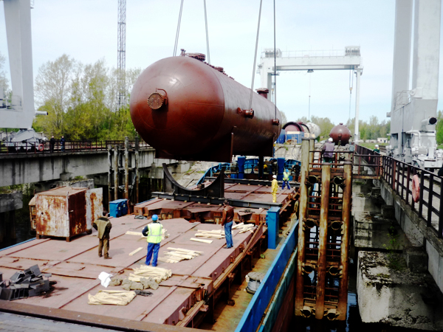
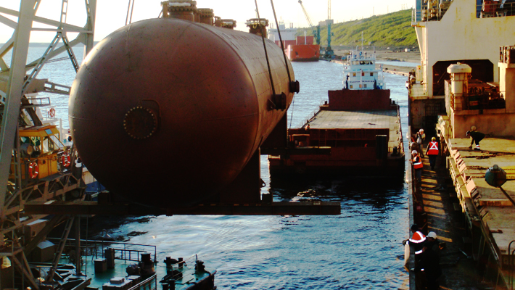
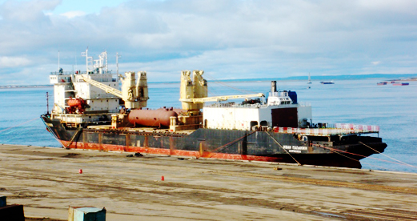
2011: Transportation of technological slug catchers
The transportation of 2 technological slug catchers from Dzerzhinsk (Nizhny Novgorod region) in the Vankor field for JSC Vankorneft Total volume of traffic: 2 heavy and oversized cargo of 200 tons
List of works done:
Loading on the quay of JSC Dzerzhinsk
Transportation to the port of Murmansk
Overload on a ship
Marine transportation to the port of Dudinka
Overload onto a barge with the subsequent delivery to the Vankor field
Dimensions of each load (LxWxH), mm: 24800 x 6100 x 6200

Slide 13
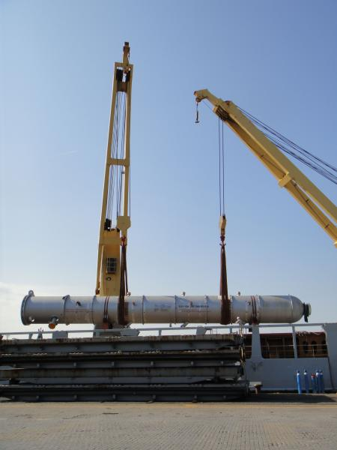
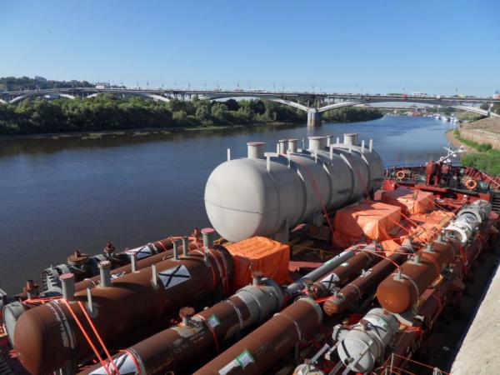
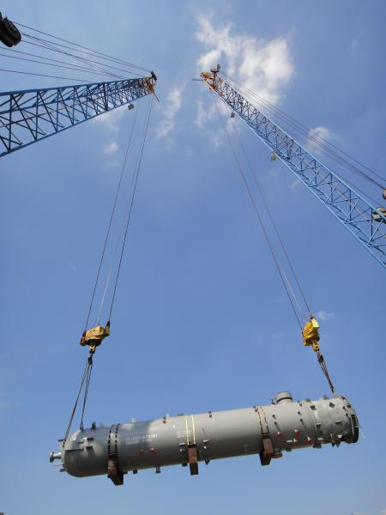
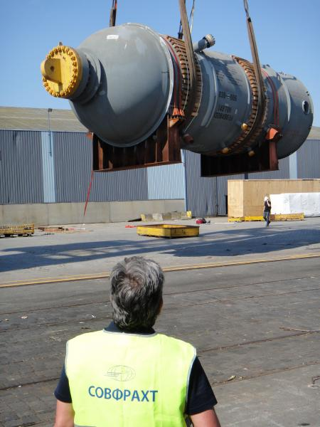
2013: Oversized equipment for CJSC Ryazan Refinery
The transportation of oversized heavy equipment for JSC Ryazan Refinery from the USA, Japan to the city of Ryazan, Russia. List of works done:
Shipment from factories - manufacturers of the USA and Japan
Consolidation in the port of Antwerp
Sorting load in the parts depending on the size
Marine transportation to the port of Rotterdam
Marine transportation to the city of Ryazan
Preparing temporary berth
Unloading equipment
Delivery to the JSC Ryazan Refinery
Length 52 m Weight up to 300 tons

Slide 14
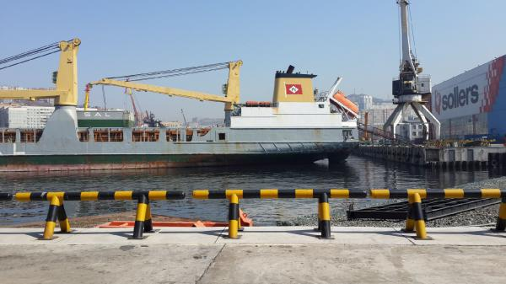
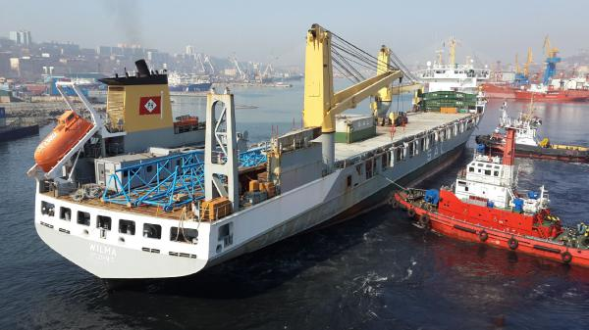
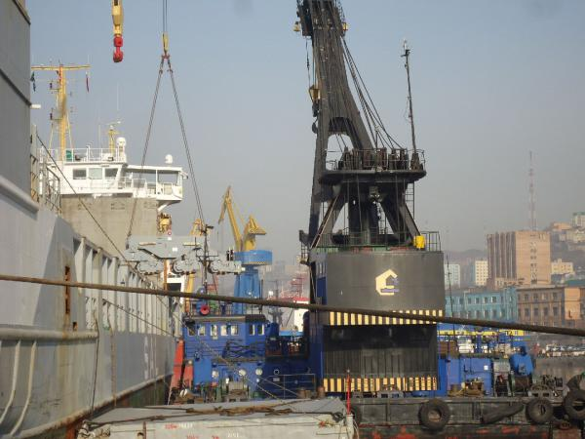
2014: Implementation of oversize cargo in the Far East
Unloading Gottwald gantry crane at Terminal Sollers-Far East, the port of Vladivostok, 2014 Customer - German shipowner, the company SAL Heavy Lift The limitation of the berth length didn’t allow to put the ship on the board side, as in a standard procedure of unloading, so it was decided to set up the ship’s stern to the berth with the intermediate overload on the floating crane.

Slide 15
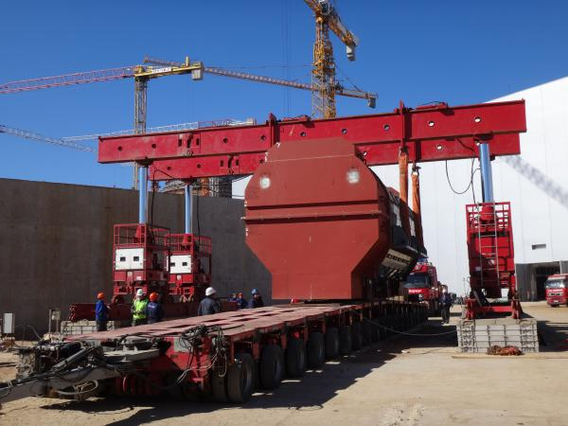
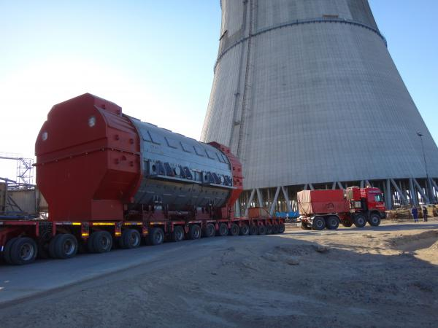
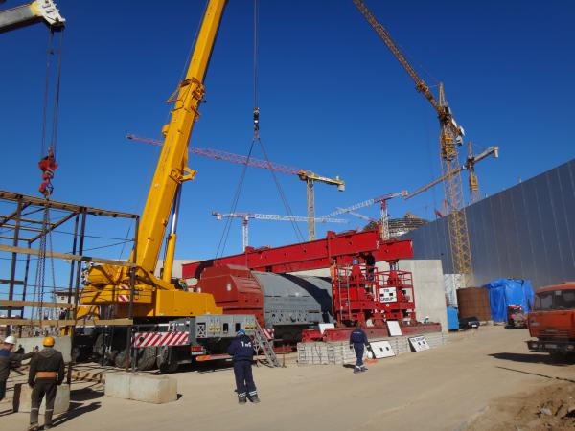
2014: Transportation of heavy oversized stator
Route: from the construction site of Leningrad NPP-2 to the storage area in Sosnovy Bor, Leningrad region.
Weight of cargo - 497,0 tons.
Customer - JSC UAT, consignee - Concern Titan-2 CJSC.
Loading the stator on the vehicle and unloading at the site was carried out with hydraulic portal system Greiner GHS-1100, with capacity of 1100 tons. Transportation of heavy cargo was performed by specialized articulated in the 2 trucks Mercedes Benz Actros and 20-axle modular trailer of Goldhofer.

Slide 16
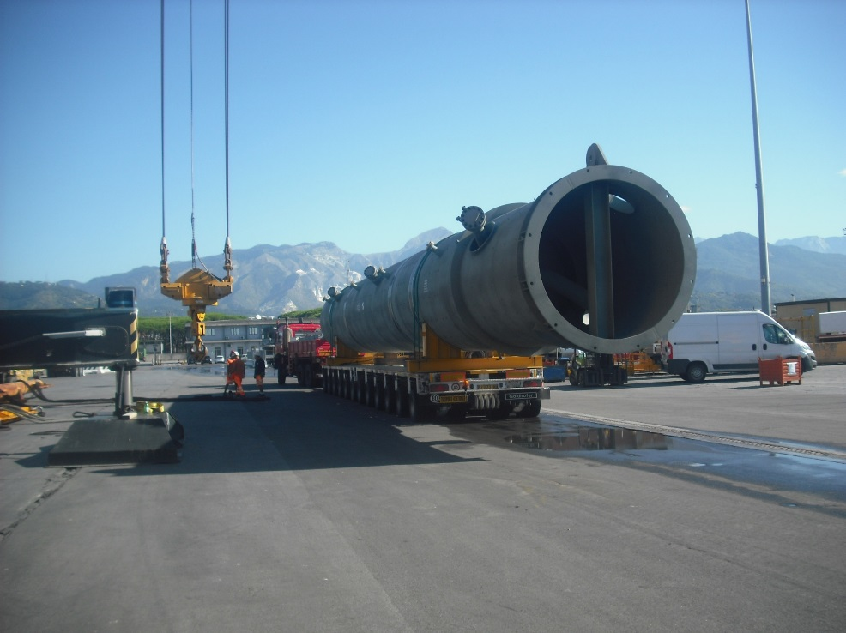
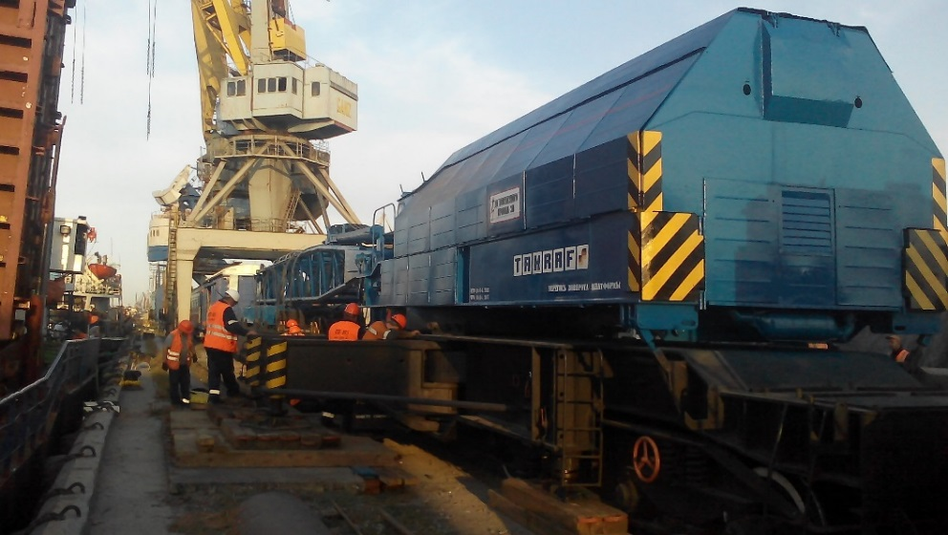
2016: Transportation for Antipinsky oil refinery
Cargo: installation system for the production of high-octane gasoline/
The total equipment amounted to 542 m3, weight - 117.5 tons
Route: the port of Marina di Carrara (Italy) – Rostov-on-don – Tyumen
Since Rostov Universal Port has the capability for handling loads only up to 64 tons, the specialists of JSC Sovfracht had to use a special railway crane EDK-1000/2, with a lifting capacity of 120 tons and Harbor crane Liebherr LHM 250 for implementing a unique operation on transfer of the equipment from the sea vessel to an auto vehicle.
After unloading the equipment, a convoy of road trains composed of trucks and low loaders semi-trailers went directly to Antipinsky oil refinery.

Slide 17
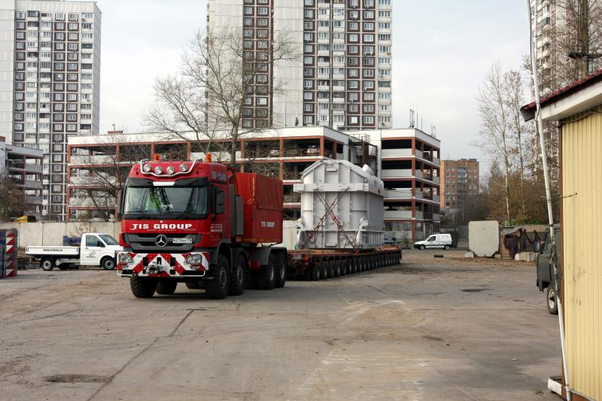
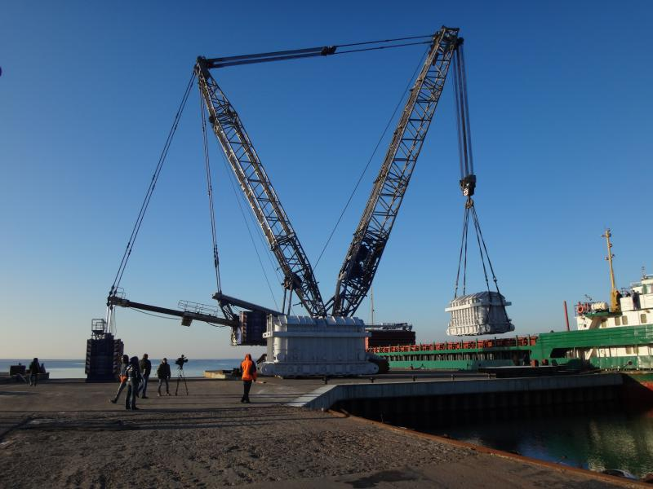
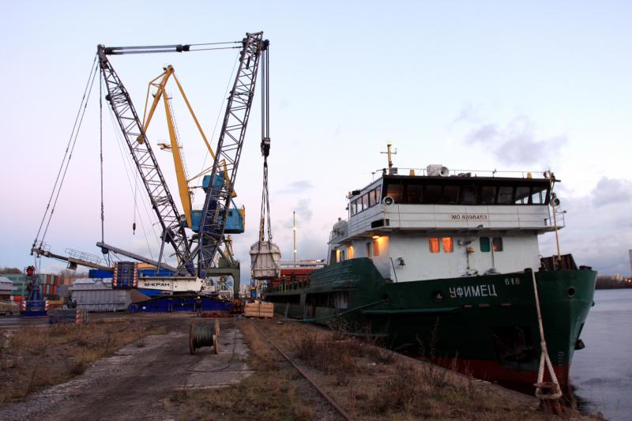
2016: Transportation of the transformers for Leningrad NPP-2
Four transformers, each of which was 297,0 tons weight were transported together using combined water-road transport.
During unloading transformers from vehicles and loading them into the hold of the vessel on the quay of the port city of Moscow crawler crane Liebherr LR 1750, a 750 t capacity was used.
Sovfracht has become the first company that performed the overload of the transformers from the hold of the ship for a specialized vehicle on the berth № 16 the Ustie in the Koporye Bay using a crane.
297 tons

Slide 18
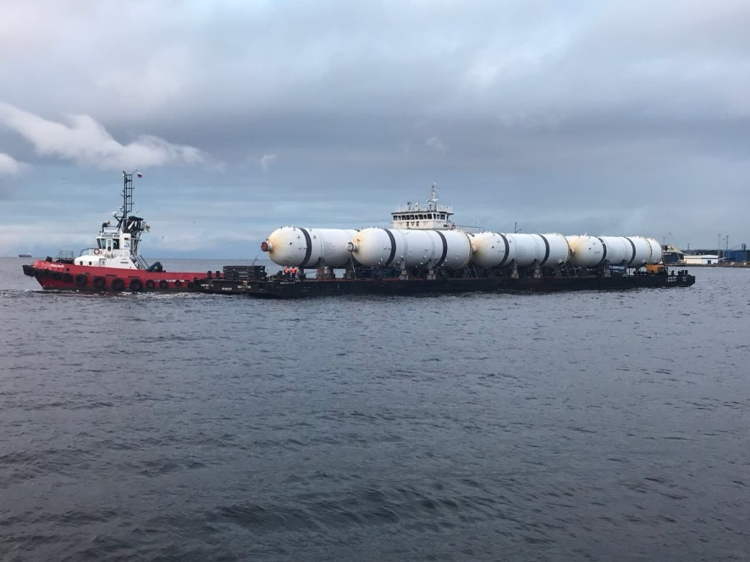
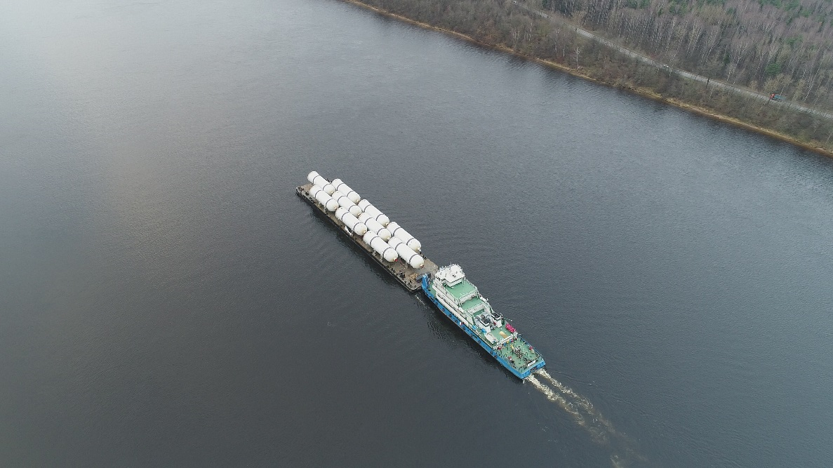
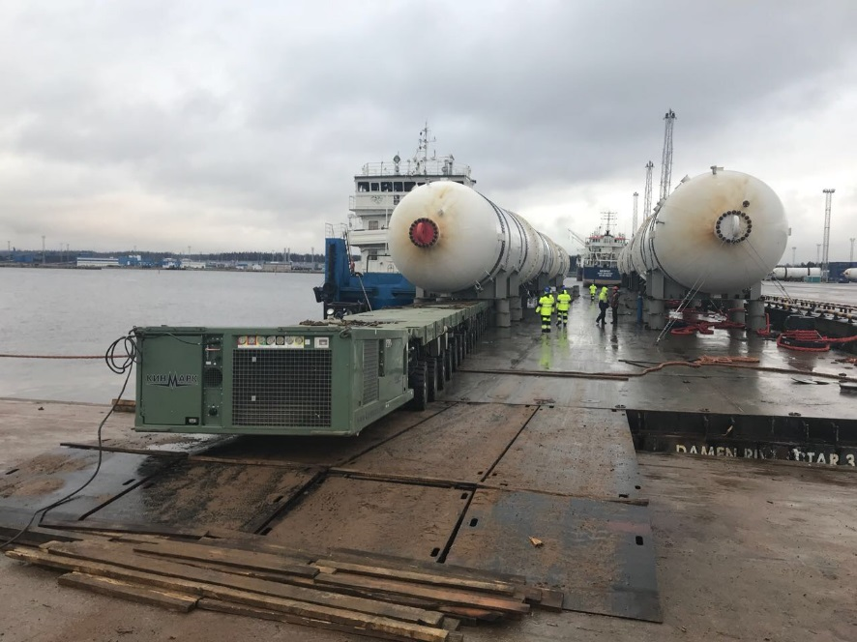
2017: Transportation of adsorbers for the project North stream - 2
The unique technology of overload a large number of similar cargos (10 adsorptive columns) from one barge to another without using of berth was used during delivery from stanitsa Varenikovskaya to sea port Ust-Luga.
The overload was realized by Ro-Ro mode directly afloat (1700 logistic and ballast operations). Refusal to use berth reduced logistic charges and kept costs down.

Slide 19
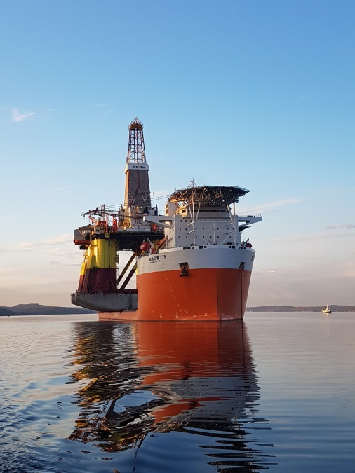
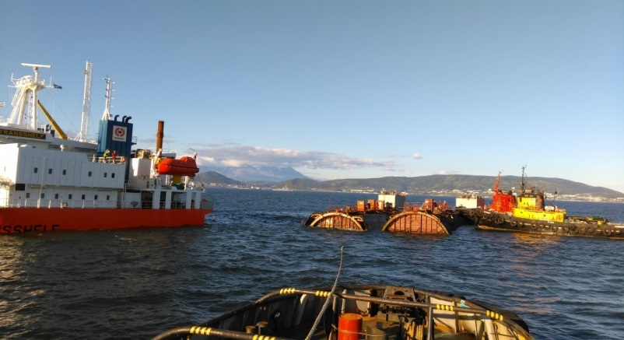
2017: Agency service
Every year JSC Sovfracht provides hundreds of vessel calls in more than 50 world ports, including arctic ports.
In 2017 JSC Sovfracht provided a semisubmersible Heavy Lift vessel call with a floating drilling outfit aboard to the port of Murmansk.
Overall length of the vessel: 221,3 m
Hull height: 42 m
Deadweight: 52 798,4
Height of the floating drilling outfit: 115 m
As an agent of the vessel and the floating drilling outfit Sovfracht provides provision and replenishment for the heading out of the vessel and maintenance of activity of the drilling outfit at the Kara sea.
Agency department of the LLC Sovfracht-Vostok provided a loading of cargo of hazard class VII at the vessel Transshelf at Kamchatka.

Slide 20
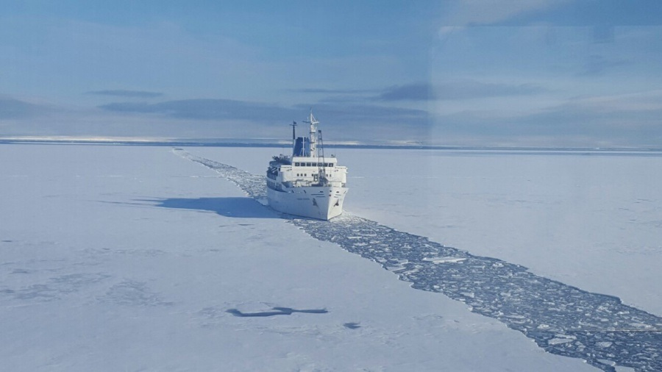
2017: The Situational Arctic Center
Sovfracht commenced the project to create The Situational Arctic Center and works on it. It is a modern ground for coordination of Maritime transport in the Arctic.
Main objectives of creation The Situational Arctic center are:
to enhance the safety and economic viability of working in the Arctic zone
to optimize the management of marine operations including the organization of the handling operations on unequipped shore
to provide visibility of the operational situation (weather, ice conditions, traffic, loads, etc.), and as a consequence – to provide the possibility of online planning and adjustment of a route taking into account all the factors, etc.
SAC starts to work in 2019
It’s a free online platform for all participants

Slide 21
Sovfracht JSC
129090, Moscow,
Olympiysky prospect, 14 - BC Diamond Hall Phone: +7 (495) 258 27 41 Fax: +7 (495) 258 28 76
www.sovfracht.ru general@sovfracht.ru

